Slide 1
Maximum Flow
Computer Science Complementary Subject
20.06.2021
Levin Hinder

Slide 2
Content
Terms
Rules
Algorithm based on an example
Result/Code
Applications

Slide 3
Terms
S: start node (home)
N: node (crossing)
T: target node (destination)
Edge: edge (road)
Height: height
S
1 | 2 ->
N
1 | 1 ->
T

Slide 4
Rules
Capacity rule
No more than the maximum capacity may flow through on one edge.
Flow consercation rule
The same amount must flow into a node as out of it, with the exception of the start node and the target node.
Height rule
The flow may only flow from a higher node to a lower node.

Slide 5
Algorithm
Height start node = number of nodes
Height of every node = 0
Fully load all edges from the start node.
while (flow conservation rule is violated)
if (neighbouring node with lower height)
if (capacity available on edge && egde flows out)
Allow as much as possible to flow on, but never more than the capacity of the edge
else if (capacity available on edge && edge flows in)
Let as much flow back as possible, but never more than the surplus or more than the capacity of the edge
else
increase height of node

Slide 6
Algorithm
Height start node = number of nodes
Height of every node = 0
0|3
0
0|1
0
0|2
0
0|1
0|2
8
0|2
0
0|4
0
0|2
0
0|1
0|3
0
0|1
0

Slide 7
Algorithm
Fully load all edges from the start node.
3|3 ->
0
0|1
0
0|2
0
0|1
0|2
8
2|2 ->
0
0|4
0
0|2
0
0|1
3|3 ->
0
0|1
0

Slide 8
Algorithm
Flowing on/back is not possible -> Height++
3|3 ->
1
0|1
0
0|2
0
0|1
0|2
8
2|2 ->
0
0|4
0
0|2
0
0|1
3|3 ->
0
0|1
0

Slide 9
Algorithm
Keep flowing as much as necessary or possible.
3|3 ->
1
1|1 ->
0
0|2
0
0|1
0|2
8
2|2 ->
0
0|4
0
0|2
0
0|1
3|3 ->
0
0|1
0

Slide 10
Algorithm
Flowing on/back is not possible -> Height++
3|3 ->
1
1|1 ->
1
0|2
0
0|1
0|2
8
2|2 ->
0
0|4
0
0|2
0
0|1
3|3 ->
0
0|1
0

Slide 11
Algorithm
Keep flowing as much as necessary or possible.
3|3 ->
1
1|1 ->
1
1|2 ->
0
0|1
0|2
8
2|2 ->
0
0|4
0
0|2
0
0|1
3|3 ->
0
0|1
0

Slide 12
Algorithm
Flowing on/back is not possible -> Height++
3|3 ->
1
1|1 ->
1
1|2 ->
1
0|1
0|2
8
2|2 ->
0
0|4
0
0|2
0
0|1
3|3 ->
0
0|1
0

Slide 13
Algorithm
Keep flowing as much as necessary or possible.
3|3 ->
1
1|1 ->
1
1|2 ->
1
0|1
1|2 ->
8
2|2 ->
0
0|4
0
0|2
0
0|1
3|3 ->
0
0|1
0

Slide 14
Algorithm
Flowing on/back is not possible -> Height++
3|3 ->
2
1|1 ->
1
1|2 ->
1
0|1
1|2 ->
8
2|2 ->
0
0|4
0
0|2
0
0|1
3|3 ->
0
0|1
0

Slide 15
Algorithm
Flowing on/back is not possible -> Height++
3|3 ->
3
1|1 ->
1
1|2 ->
1
0|1
1|2 ->
8
2|2 ->
0
0|4
0
0|2
0
0|1
3|3 ->
0
0|1
0

Slide 16
Algorithm
Flowing on/back is not possible -> Height++
3|3 ->
4
1|1 ->
1
1|2 ->
1
0|1
1|2 ->
8
2|2 ->
0
0|4
0
0|2
0
0|1
3|3 ->
0
0|1
0

Slide 17
Algorithm
Flowing on/back is not possible -> Height++
3|3 ->
5
1|1 ->
1
1|2 ->
1
0|1
1|2 ->
8
2|2 ->
0
0|4
0
0|2
0
0|1
3|3 ->
0
0|1
0

Slide 18
Algorithm
Flowing on/back is not possible -> Height++
3|3 ->
6
1|1 ->
1
1|2 ->
1
0|1
1|2 ->
8
2|2 ->
0
0|4
0
0|2
0
0|1
3|3 ->
0
0|1
0

Slide 19
Algorithm
Flowing on/back is not possible -> Height++
3|3 ->
7
1|1 ->
1
1|2 ->
1
0|1
1|2 ->
8
2|2 ->
0
0|4
0
0|2
0
0|1
3|3 ->
0
0|1
0

Slide 20
Algorithm
Flowing on/back is not possible -> Height++
3|3 ->
8
1|1 ->
1
1|2 ->
1
0|1
1|2 ->
8
2|2 ->
0
0|4
0
0|2
0
0|1
3|3 ->
0
0|1
0

Slide 21
Algorithm
Flowing on/back is not possible -> Height++
3|3 ->
9
1|1 ->
1
1|2 ->
1
0|1
1|2 ->
8
2|2 ->
0
0|4
0
0|2
0
0|1
3|3 ->
0
0|1
0

Slide 22
Algorithm
Keep flowing as much as necessary or possible.
3|3 ->
2|3 <-
9
1|1 ->
1
1|2 ->
1
0|1
1|2 ->
8
2|2 ->
0
0|4
0
0|2
0
0|1
3|3 ->
0
0|1
0

Slide 23
Algorithm
Flowing on/back is not possible -> Height++
1|3 ->
9
1|1 ->
1
1|2 ->
1
0|1
1|2 ->
8
2|2 ->
1
0|4
0
0|2
0
0|1
3|3 ->
0
0|1
0

Slide 24
Algorithm
Keep flowing as much as necessary or possible.
1|3 ->
9
1|1 ->
1
1|2 ->
1
0|1
1|2 ->
8
2|2 ->
1
2|4 ->
0
0|2
0
0|1
3|3 ->
0
0|1
0

Slide 25
Algorithm
Flowing on/back is not possible -> Height++
1|3 ->
9
1|1 ->
1
1|2 ->
1
0|1
1|2 ->
8
2|2 ->
1
2|4 ->
1
0|2
0
0|1
3|3 ->
0
0|1
0

Slide 26
Algorithm
Keep flowing as much as necessary or possible.
1|3 ->
9
1|1 ->
1
1|2 ->
1
0|1
1|2 ->
8
2|2 ->
1
2|4 ->
1
2|2 ->
0
0|1
3|3 ->
0
0|1
0

Slide 27
Algorithm
Flowing on/back is not possible -> Height++
1|3 ->
9
1|1 ->
1
1|2 ->
1
0|1
1|2 ->
8
2|2 ->
1
2|4 ->
1
2|2 ->
0
0|1
3|3 ->
1
0|1
0

Slide 28
Algorithm
Keep flowing as much as necessary or possible.
1|3 ->
9
1|1 ->
1
1|2 ->
1
0|1
1|2 ->
8
2|2 ->
1
2|4 ->
1
2|2 ->
0
0|1
3|3 ->
1
1|1 ->
0

Slide 29
Algorithm
Flowing on/back is not possible -> Height++
1|3 ->
9
1|1 ->
1
1|2 ->
1
0|1
1|2 ->
8
2|2 ->
1
2|4 ->
1
2|2 ->
0
0|1
3|3 ->
1
1|1 ->
1

Slide 30
Algorithm
Flowing on/back is not possible -> Height++
1|3 ->
9
1|1 ->
1
1|2 ->
1
0|1
1|2 ->
8
2|2 ->
1
2|4 ->
1
2|2 ->
0
0|1
3|3 ->
1
1|1 ->
2

Slide 31
Algorithm
Keep flowing as much as necessary or possible.
1|3 ->
9
1|1 ->
1
1|2 ->
1
0|1
1|2 ->
8
2|2 ->
1
2|4 ->
1
2|2 ->
0
1|1 ->
3|3 ->
1
1|1 ->
2

Slide 32
Algorithm
Flowing on/back is not possible -> Height++
1|3 ->
9
1|1 ->
1
1|2 ->
1
0|1
1|2 ->
8
2|2 ->
1
2|4 ->
2
2|2 ->
0
1|1 ->
3|3 ->
1
1|1 ->
2

Slide 33
Algorithm
Keep flowing as much as necessary or possible.
1|3 ->
9
1|1 ->
1
1|2 ->
1
0|1
1|2 ->
8
2|2 ->
1
2|4 ->
1|4 <-
2
2|2 ->
0
1|1 ->
3|3 ->
1
1|1 ->
2

Slide 34
Algorithm
Flowing on/back is not possible -> Height++
1|3 ->
9
1|1 ->
1
1|2 ->
1
0|1
1|2 ->
8
2|2 ->
2
1|4 ->
2
2|2 ->
0
1|1 ->
3|3 ->
1
1|1 ->
2

Slide 35
Algorithm
Keep flowing as much as necessary or possible.
1|3 ->
9
1|1 ->
1
1|2 ->
1
1|1 ->
1|2 ->
8
2|2 ->
2
1|4 ->
2
2|2 ->
0
1|1 ->
3|3 ->
1
1|1 ->
2

Slide 36
Algorithm
Flowing on/back is not possible -> Height++
1|3 ->
9
1|1 ->
2
1|2 ->
1
1|1 ->
1|2 ->
8
2|2 ->
2
1|4 ->
2
2|2 ->
0
1|1 ->
3|3 ->
1
1|1 ->
2

Slide 37
Algorithm
Keep flowing as much as necessary or possible.
1|3 ->
9
1|1 ->
2
2|2 ->
1
1|1 ->
1|2 ->
8
2|2 ->
2
1|4 ->
2
2|2 ->
0
1|1 ->
3|3 ->
1
1|1 ->
2

Slide 38
Algorithm
Keep flowing as much as necessary or possible.
1|3 ->
9
1|1 ->
2
2|2 ->
1
1|1 ->
2|2 ->
8
2|2 ->
2
1|4 ->
2
2|2 ->
0
1|1 ->
3|3 ->
1
1|1 ->
2

Slide 39
Algorithm
Flowing on/back is not possible -> Height++
1|3 ->
9
1|1 ->
2
2|2 ->
1
1|1 ->
2|2 ->
8
2|2 ->
2
1|4 ->
2
2|2 ->
0
1|1 ->
3|3 ->
2
1|1 ->
2

Slide 40
Algorithm
Flowing on/back is not possible -> Height++
1|3 ->
9
1|1 ->
2
2|2 ->
1
1|1 ->
2|2 ->
8
2|2 ->
2
1|4 ->
2
2|2 ->
0
1|1 ->
3|3 ->
3
1|1 ->
2

Slide 41
Algorithm
Flowing on/back is not possible -> Height++
1|3 ->
9
1|1 ->
2
2|2 ->
1
1|1 ->
2|2 ->
8
2|2 ->
2
1|4 ->
2
2|2 ->
0
1|1 ->
3|3 ->
4
1|1 ->
2

Slide 42
Algorithm
Flowing on/back is not possible -> Height++
1|3 ->
9
1|1 ->
2
2|2 ->
1
1|1 ->
2|2 ->
8
2|2 ->
2
1|4 ->
2
2|2 ->
0
1|1 ->
3|3 ->
5
1|1 ->
2

Slide 43
Algorithm
Flowing on/back is not possible -> Height++
1|3 ->
9
1|1 ->
2
2|2 ->
1
1|1 ->
2|2 ->
8
2|2 ->
2
1|4 ->
2
2|2 ->
0
1|1 ->
3|3 ->
6
1|1 ->
2

Slide 44
Algorithm
Flowing on/back is not possible -> Height++
1|3 ->
9
1|1 ->
2
2|2 ->
1
1|1 ->
2|2 ->
8
2|2 ->
2
1|4 ->
2
2|2 ->
0
1|1 ->
3|3 ->
7
1|1 ->
2

Slide 45
Algorithm
Flowing on/back is not possible -> Height++
1|3 ->
9
1|1 ->
2
2|2 ->
1
1|1 ->
2|2 ->
8
2|2 ->
2
1|4 ->
2
2|2 ->
0
1|1 ->
3|3 ->
8
1|1 ->
2

Slide 46
Algorithm
Flowing on/back is not possible -> Height++
1|3 ->
9
1|1 ->
2
2|2 ->
1
1|1 ->
2|2 ->
8
2|2 ->
2
1|4 ->
2
2|2 ->
0
1|1 ->
3|3 ->
9
1|1 ->
2

Slide 47
Algorithm
Keep flowing as much as necessary or possible.
1|3 ->
9
1|1 ->
2
2|2 ->
1
1|1 ->
2|2 ->
8
2|2 ->
2
1|4 ->
2
2|2 ->
0
1|1 ->
3|3 ->
2|3 <-
9
1|1 ->
2

Slide 48
Algorithm
1|3 ->
9
1|1 ->
2
2|2 ->
1
1|1 ->
2|2 ->
8
2|2 ->
2
1|4 ->
2
2|2 ->
0
1|1 ->
1|3 ->
9
1|1 ->
2

Slide 49
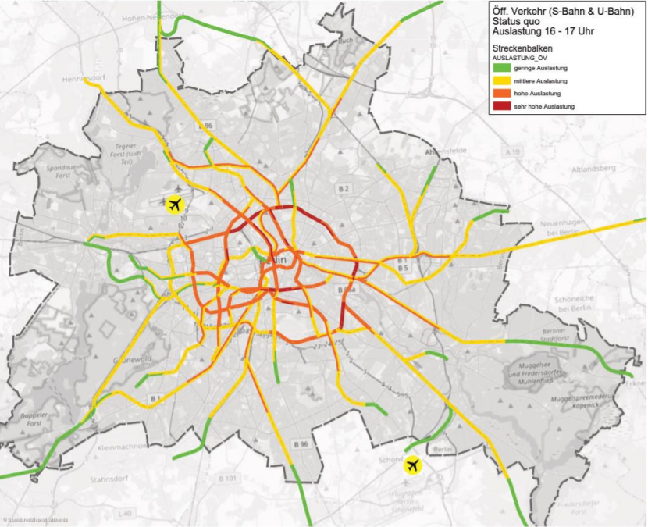
Applications
Road traffic
Rail transport
Data traffic in server
Distribution of goods to customers

